Slide 1
Upper motor neuron control of the brainstem and spinal cord
By: Nicole Phillips

Slide 2
Learning objectives
Describe the general organization and functional properties of the motor system.
Describe how different pathways influence LMNs and movement.
Identify the signs of UMN damage and the anatomical basis of these signs.

Slide 3
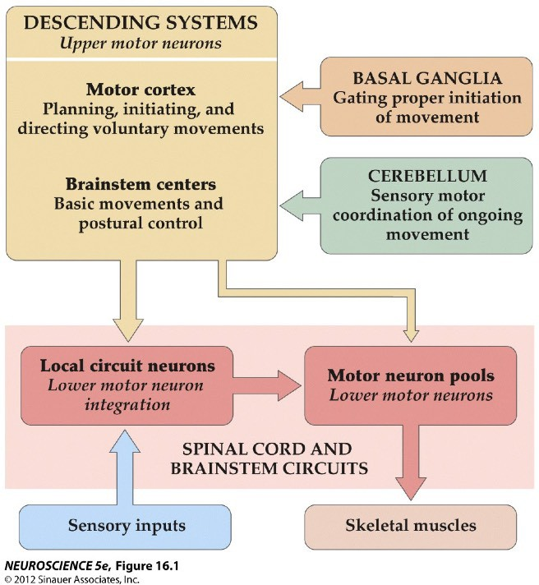
Four Neural Centers for Movement
3
Upper Motor Neurons (UMNs)
Top-down control of movement
2
Modulation of motor plans
4
1
Lower motor neurons (LMNs)
“Final common path” for initiating movement

Slide 4
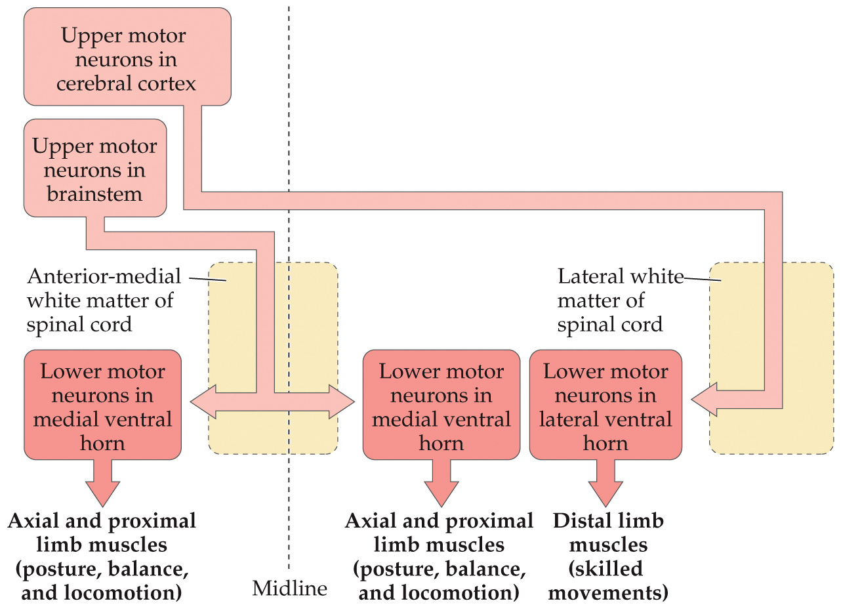
Upper motor neurons coordinate activity of lower motor neurons

Slide 5
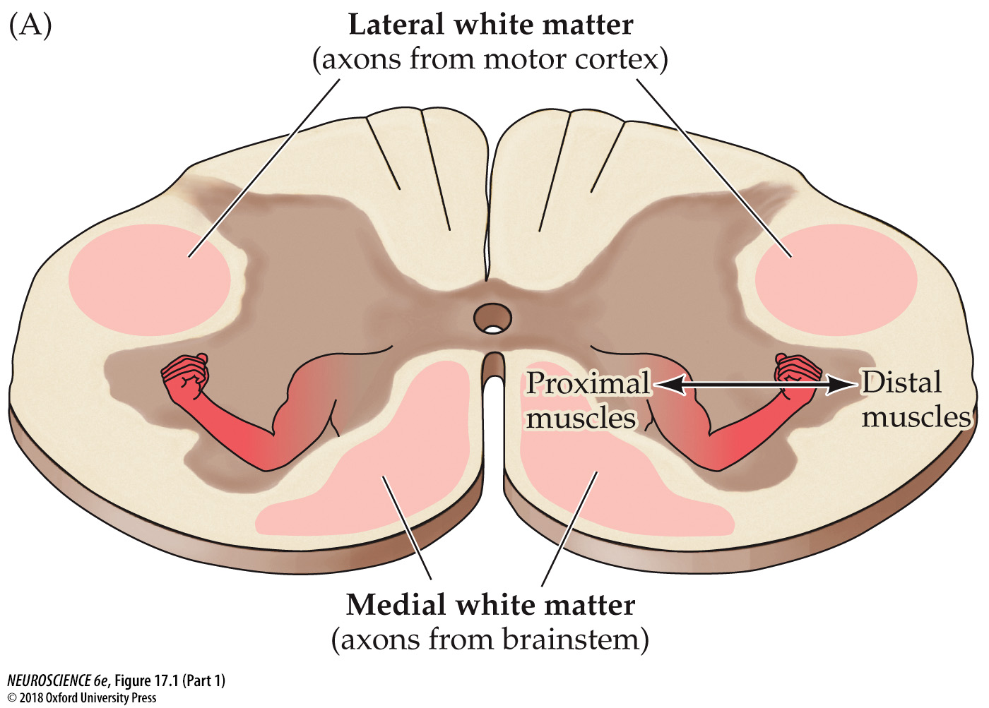
The Medial division of descending motor tracts
Axons from the brainstem
  Controls axial (trunk) muscles
  Primarily related to posture, balance and locomotion
Main sections:
  Colliculospinal
  Rubrospinal
  Vestibulospinal
  Reticulospinal

Slide 6
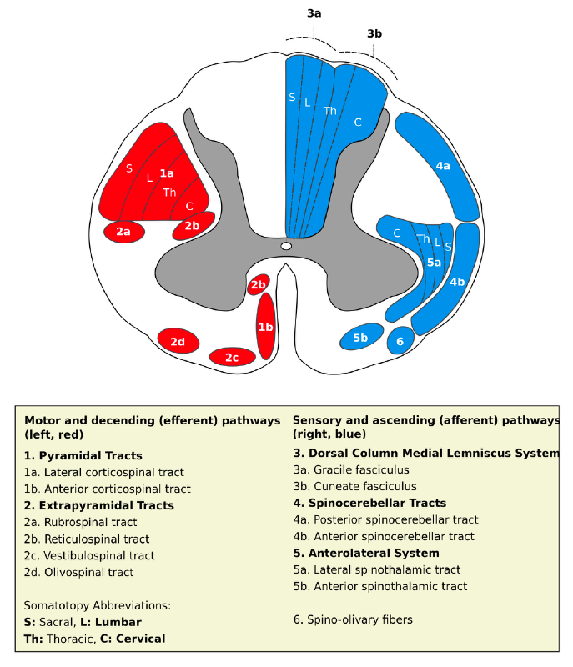

Slide 7
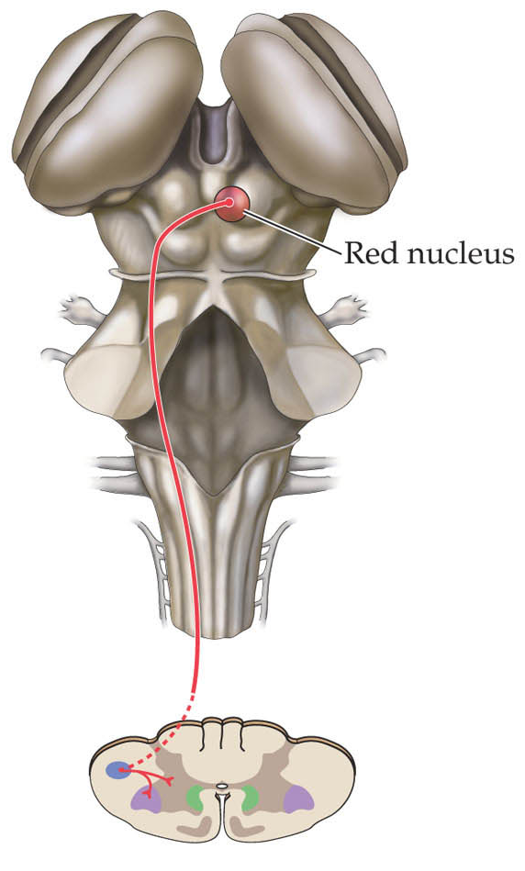
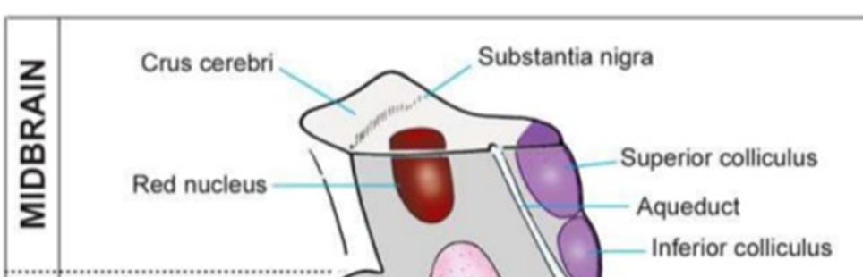
Rubrospinal Pathway
UMNs in the red nucleus
Control forearms in non-human mammals, but unclear in humans

Slide 8
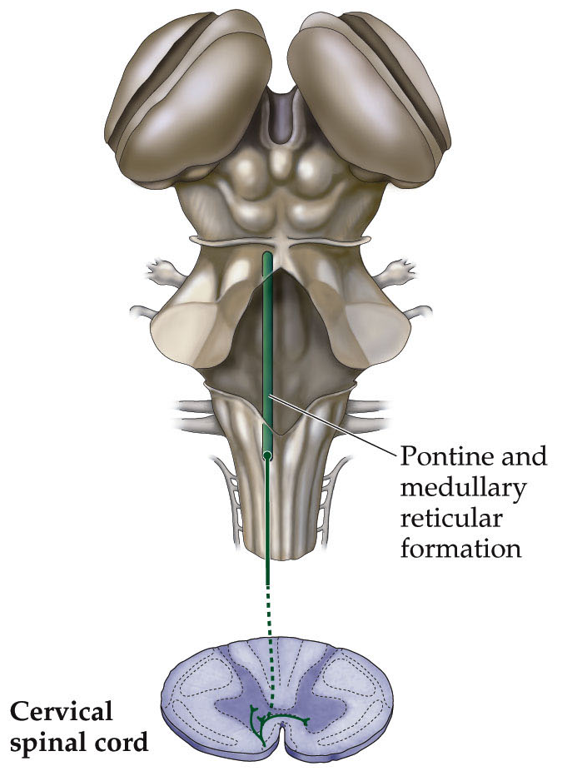
Colliculospinal Pathway
UMNs in the superior colliculus
involved in orienting movements of the head, eyes, and neck
Superior colliculus

Slide 9
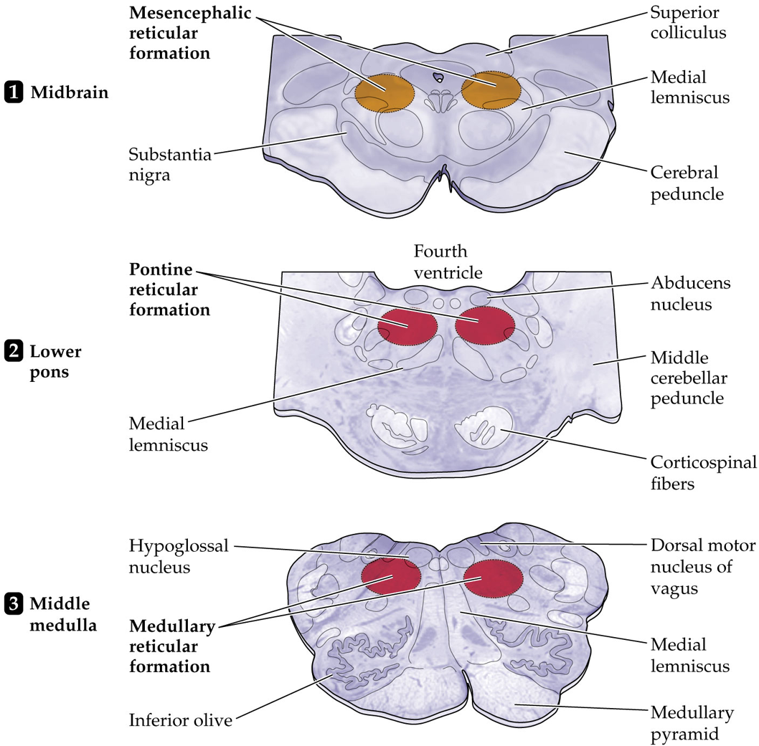
Reticulospinal Pathway
UMNs in the reticular formation
Body posture & position
  Coordinate axial (trunk) and proximal limb movement
Autonomic (e.g. heart and lungs) and stereotypic behaviors (e.g., stepping)

Slide 10
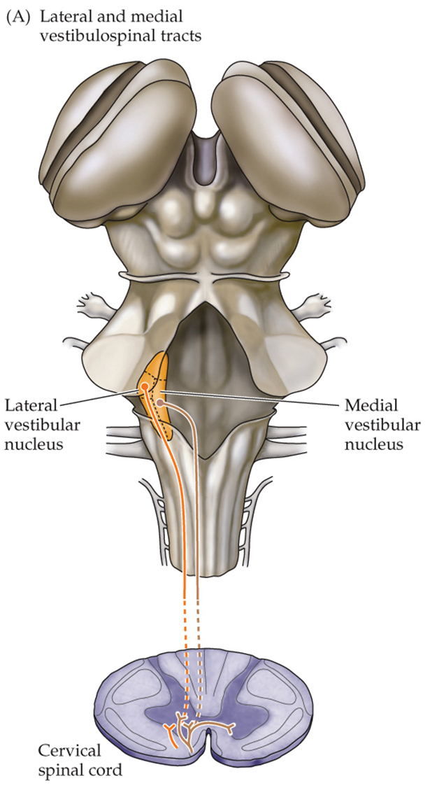
Vestibulospinal Pathways
UMNs in the vestibular nuclear complex
  Medial: terminate bilaterally in the medial ventral part of cervical spinal cord
    regulate head position and protect via the dorsiflexion reflex.
  Lateral: terminate ipsilaterally in the medial anterior white matter
    governs proximal upper limb muscles and mediates reflexes that activate extensor (anti-gravity) muscles.

Slide 11
The Lateral division of descending motor tracts
Axons from the cortical areas
  Controls distal muscles
  Primarily related to planning, initiating, and directing voluntary movements
Main sections:
  Corticospinal
  Corticobulbar

Slide 13
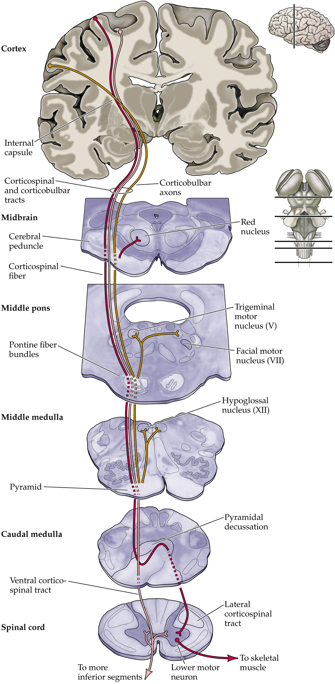
Corticobulbar pathway
Pathway carrying motor information from motor cortex to brainstem nuclei.
There is also a massive projection that terminates among nuclei in the base of the pons that project in turn to the cerebellum (the corticopontine tract)

Slide 14

Corticospinal pathway
Pathway carrying motor information from motor cortex to the spinal cord.
  Lateral: cross midline in the caudal medulla.
    skilled movements of the extremities (especially hands)
  Ventral (anterior): remain ipsilateral.
    postural control

